Slide 1
Energy Planning using Mathematics
COFSP Fellow
Fairfield H.S. Pre-Calculus

Slide 2
Unit Overview
Topic: Real World Math Applications
Standards: Common Core State Standards – Mathematics (CCSS)
Next Generation Science Standards (NGSS)

Slide 3
Activity Structure

Slide 4
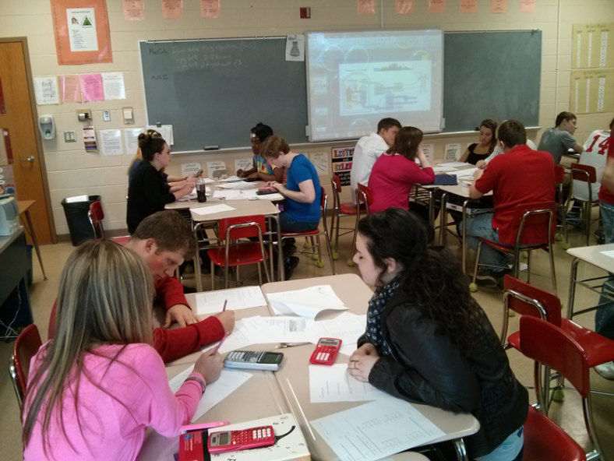
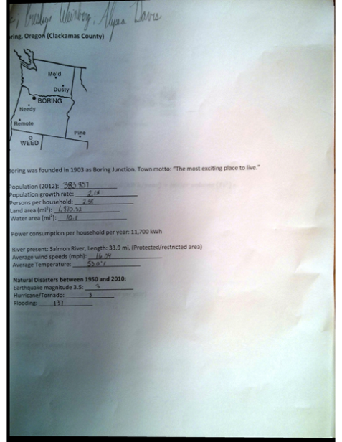
Student Work
Students worked in team of 5, up to 6 teams

Slide 5
Implementation

Slide 6
Engineering Design Process (EDP) & ACS
All 7 steps of EDP & Addressing Real World Problems, Careers and Societal Impact (ACS), utilized.
Step 1: Students identified problem
Step 2: Criteria and Constraints were supplied
Step 3 & 4: Students calculated energy requirements based on info of area.
Step 5: Based on area restrictions, students evaluated what source of electricity they can design.
Step 6: Energy supply combinations were tried in order to supply adequate electricity to population
Step 7 & 8: Students designed electricity source and refined calculations after review
This activity is an ideal ACS problem.

Slide 7
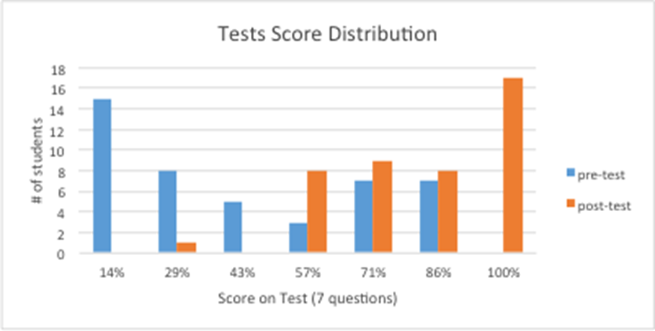
Assessment Results
This Activity covered all aspects of math for real world application. The pre and post test given was the same.
Students currently taking Physics generally performed better.

Slide 8
Conclusion
Key objective was achieved. Students are exposed to math applications in the real world.
One student summarized this as a “long fun word problem”.
If I had grasped their attention better on the first day, I could have possible saved some time in the activity implementation.

